Slide 1
Recurrent Neural Network
By: Joel Jacob John
ID: STB03-T0003

Slide 2
What is Recurrent Neural Network?
Recurrent Neural Network(RNN) is a type of Neural Network where the output from the previous step is fed as input to the current step.
RNN has a concept of “memory” which remembers all information about what has been calculated till time step t. RNNs are called recurrent because they perform the same task for every element of a sequence, with the output being depended on the previous computations.
Use Cases: Natural Language Processing (NLP), Speech Recognition

Slide 3
Why Recurrent Neural Network (RNN)
In a general neural network, an input is fed to an input layer and is further processed through number of hidden layers and a final output is produced, with an assumption that two successive inputs are independent of each other or input at time step t has no relation with input at timestep t-1.
However, this assumption is not true in a number of real-life scenarios. For instance, if one wants to predict the next word in a sequence then it is imperative that dependence on previous observations is considered.

Slide 4
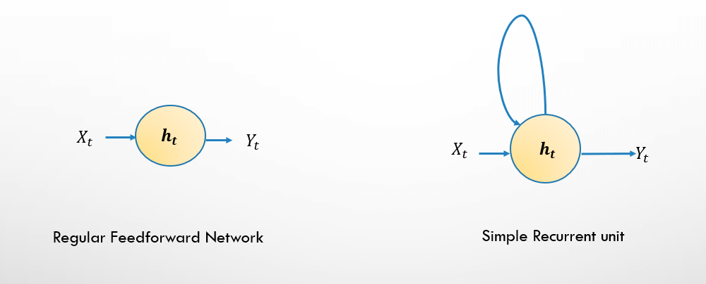
Architecture of Recurrent Neural Network
Xt is the input and Y is output at timestep t then all we need to do is create a feedback connection from hidden layer to itself to access information at time step t-1. Feedback loop implies that there's a delay of one time unit. So one of input units into ht isht-1 ,in turns hidden layer takes in both ht and its own last value. So in nutshell this feedback loop allows information to be passed from one step of the network to the next and hence acts as memory in network

Slide 5
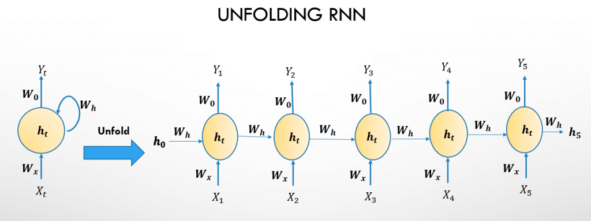
Unfolding a Recurrent Neural Network
A recurrent neural network can be thought of as multiple copies of a feedforward network network, each passing a message to a successor.

Slide 6
How Recurrent Neural Network works
The above diagram has outputs at each time step, but depending on the task this may not be necessary. For example, when predicting the sentiment of a sentence we may only care about the final output, not the prediction after each word. Similarly, we may not need inputs at each time step. The main feature of an RNN is its hidden state, which captures some information about a sequence.

Slide 7
Applications of RNNs in real life
Voice classification:- For example you want to classify between male & female voices then you’d have sound samples from male & female voices. So you classify in to either of the classes by making use of entire sequence of information.
Sentiment classification – One can leverage RNNs to classify sentiment of a texts like movie or product review or tweet etc into different classes .

Slide 8
Continued : Applications of RNNs in real life
Image Captioning – For tasks like Image captioning , we have a single input – the image, and a series or sequence of words as output.
Language Translation – This basically means that we have some text in a particular language let’s say Spanish , and we wish to translate it in English. Each language has it’s own semantics and would have varying lengths for the same sentence.

Slide 9
Advantages
Possibility of processing input of any length
Model size not increasing with size of input
Computation takes into account historical information

Slide 10
Thank You

